Slide 1

Optimal Investment location
The goal of this analysis is to determine the best and worst suburbs in Melbourne for real estate investment based on a scoring system. This system evaluates properties based on various factors such as distance from the city center, property features, and suburb density

Slide 2
The dataset contains several attributes of properties in Melbourne, which include: - Suburb location - Distance from the city center - Number of rooms, bedrooms, and bathrooms - Availability of car spaces - Land and building area - Age of the building - Density of properties in the suburb `inf` values, which are placeholders for infinity, are replaced with `NaN` to allow for numerical operations.

Slide 3
Normalization:
To compare these attributes on an equal footing, we normalize them to a scale of 0 to 1. This is done by subtracting the minimum value from each value in the column and then dividing by the range of the column.
Scoring Function:
A scoring function is defined to apply the weights to each normalized feature. The weights are as follows:
- `Distance`: -1 (closer to city center is better)
- `Rooms`: 1
- `Bedroom`: 1
- `Bathroom`: 1
- `Car`: 1
- `Landsize`: 1
- `BuildingArea`: 1
- `BuildingAge`: -0.5 (newer buildings might be preferred)
- `Propertycount`: 1 (less density is presumed to be better)

Slide 4
Calculating Scores:
Each property is scored by multiplying its features by their respective weights and summing the results. These scores represent the investment potential of the property, with higher scores indicating a more attractive investment.
Grouping by Suburb:
The properties are then grouped by suburb, and the average score for each suburb is calculated. This gives an insight into the overall investment potential of each suburb.
Results:
The suburbs are ranked based on their average scores, and the top 5 suburbs with the highest scores are identified as the best for investment. Conversely, the suburbs with the lowest scores are identified as the worst for investment.
The analysis provides a data-driven approach to identify attractive and unattractive suburbs for real estate investment in Melbourne. This methodological approach can be enhanced further by integrating more direct measures such as crime rates, school ratings, and amenities when such data becomes available.

Slide 5
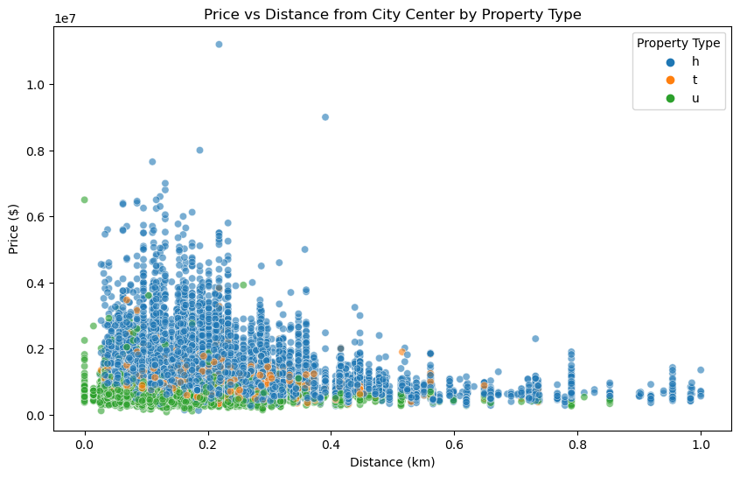
Graph 1

